Slide 1
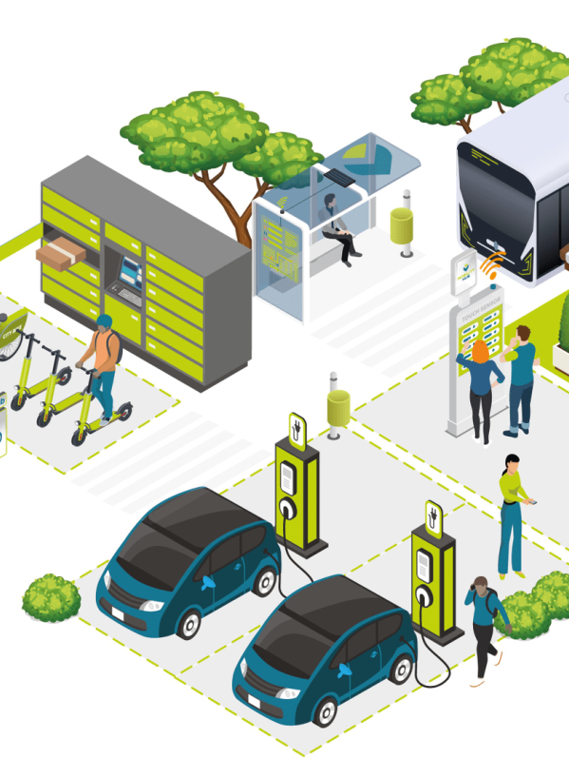

OSLO Passenger Transport Hubs:
Business workshop
Welcome!
Tuesday 26th of April 2022
Virtual workshop – Microsoft Teams
We start at 09:05am

Slide 2



Before we start…
Mute yourself during the meeting
Raise your hand before speaking. We encourage interaction!
Questions and suggestions can always be communicated via the chat.
Recorded
yes/no questions can be answered via the chat:
Yes = +1
No = - 1
Neutral = 0

Slide 3


Objective
An introduction of the OSLO Passenger Transport Hub track
Brainstorming about use cases and requirements for this data standard

Slide 4
Topics
09:00 - 09:10 AM | Welcome and introduction | Arne Scheldeman (DV)
09:10 - 09:20 AM | Project introduction | Clara Pezuela & Tom Callens (GreenMov)
09:20 - 09:35 AM | Introduction to OSLO | Arne Scheldeman (DV)
09:35 - 10:15 AM | Flemish model OSLO Hoppinpunten | Joris Cornu (DMOW) Arne Scheldeman (DV)
10:15 - 10:30 AM | Break
10:30 - 10:50 AM | Model explained by real-life example | Arne Scheldeman (DV)
10:50 - 11:20 AM | Brainstorm: use cases and expectations | Arne Scheldeman (DV)
11:20 - 11:40 AM | Mapping models | Arne Scheldeman (DV)
11:40 - 12:00 AM | Q&A en next steps | Arne Scheldeman (DV)

Slide 5
Introduction

Slide 6

Who is who?

Slide 7

Project introduction
Green mobility data models for smart ecosystems
Clara Pezuela
Project Coordinator - GreenMov
26 April 2022

Slide 8
GreenMov in a nutshell
Project mission
Harmonization of data and development of services for a more sustainable mobility in urban areas
Expected impact
reducing the pollution due to mobility
promote alternative and cleaner mobility modes
Technical challenges
Common vocabulary (OSLO) and data models (Smart Data Models)
Scalable and federated architectures for context management
Customizable digital services
Outcomes for the community
Extended Smart Data Models
New building block for Context Broker selection in federated architectures (Source Selection)
Advance green mobility services for cities/regions
Reference architecture for scalable Context Broker and set of guidelines for deployment
A white paper with lessons learned for other cities
GreenMov

Slide 9
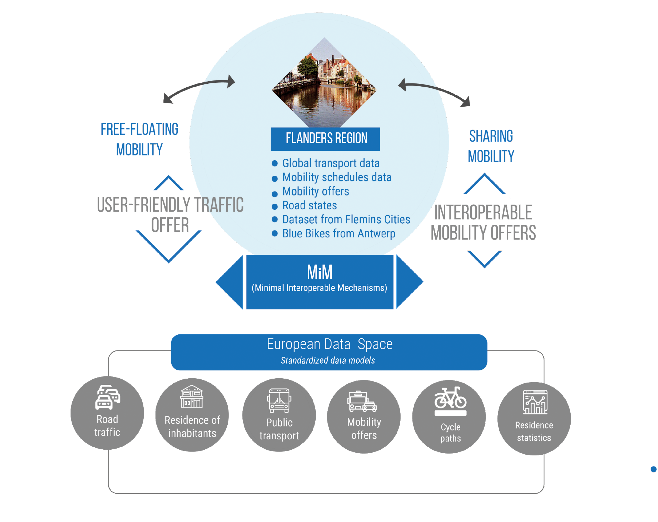
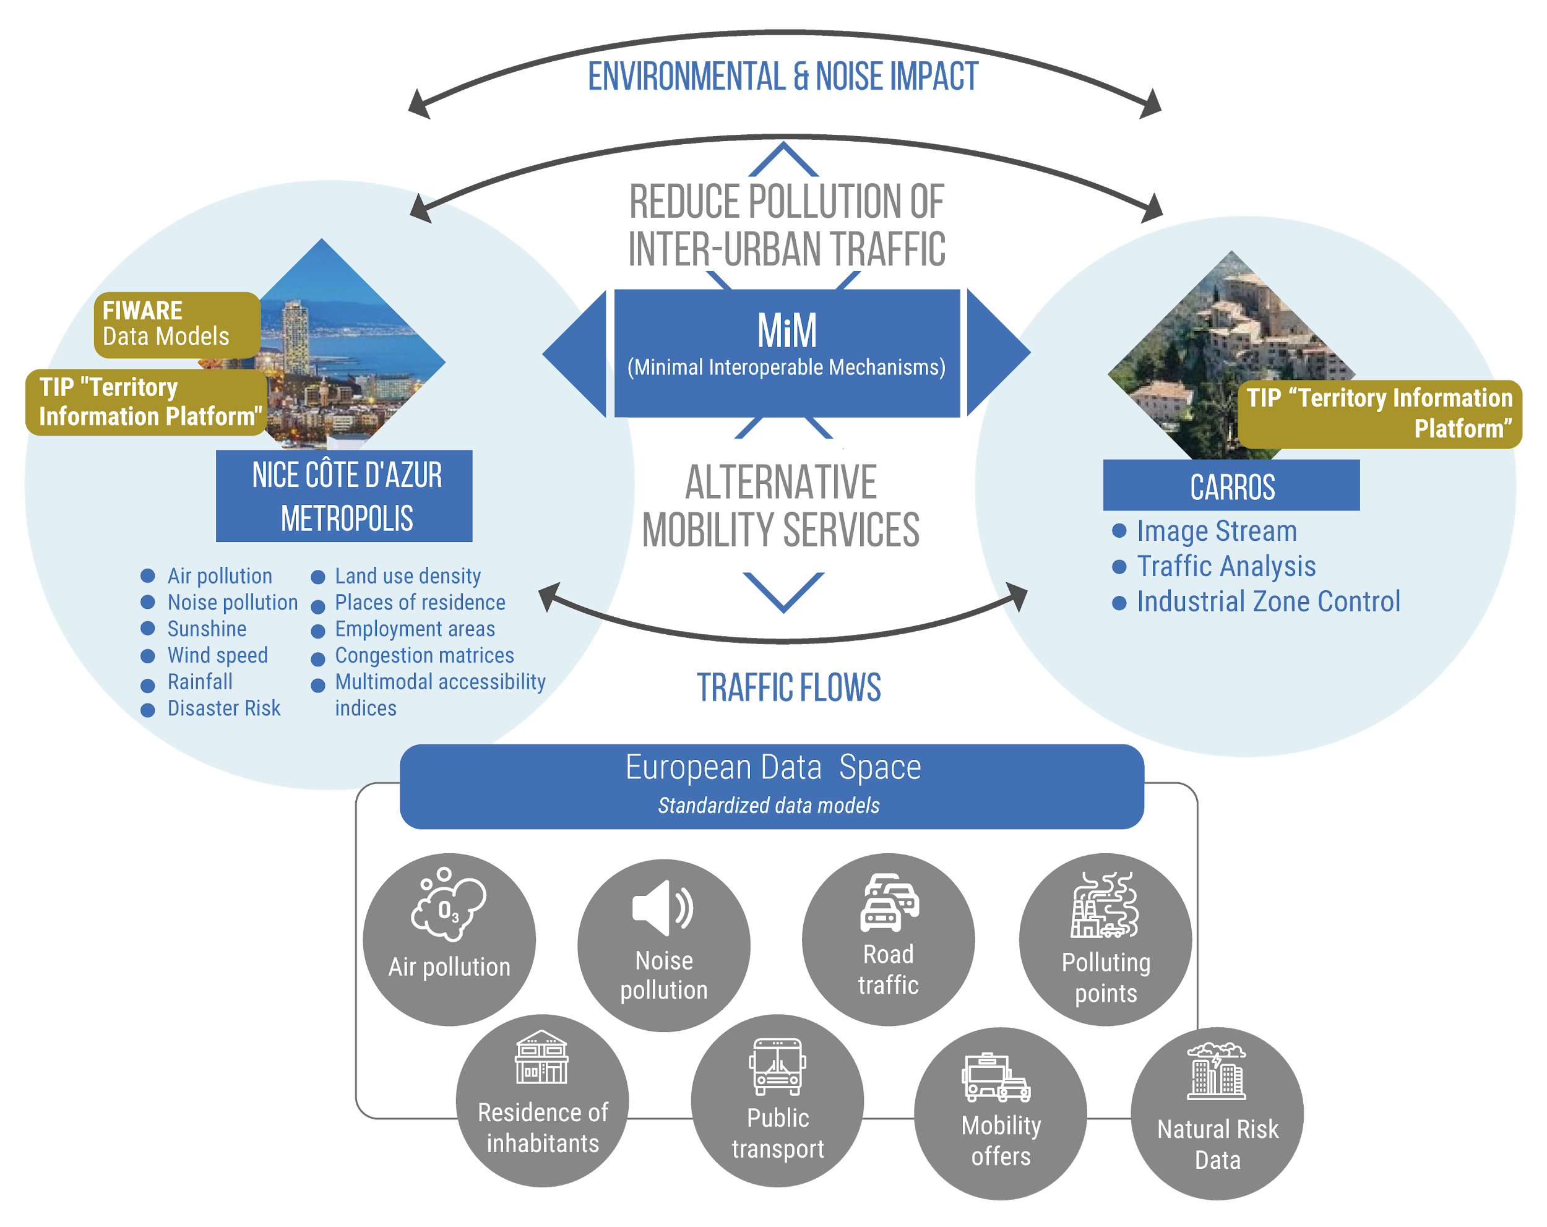
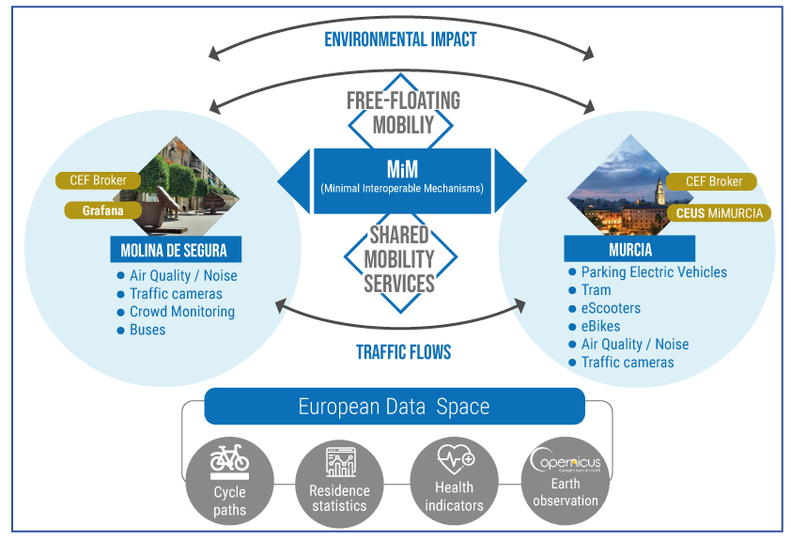
GreenMov pilots
Nice, Flanders, Murcia&Molina De Segura

Slide 10
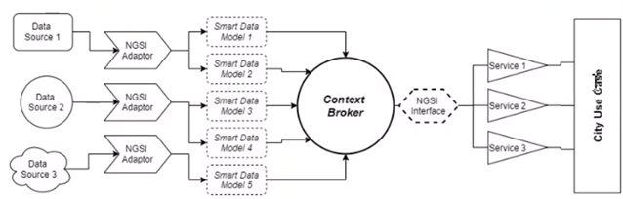
GreenMov outcomes so far
Extended Smart Data Models
AirQualityMonitoring
AirQualityObserved
NoiseLevelObserved
ParkingSpot
station_information
station_status
TrafficFlowObserved
WeatherObserved
To be created
Noise pollution
Vehicle Emission Label
Public Transport
Services under definition
Air Quality Index calculation
Air Quality forecasting
Traffic environmental impact calculation
Traffic forecasting
Bikes’ availability forecasting
Bicycle real time availability
Noise annoyance calculation
Noise annoyance forecasting
Traffic recommendations generation

Slide 11
OSLO and FIWARE Smart Data Models
How work together
A smart data model that is aligned with the vocabulary used in OSLO will be created
With the smart data model specification, developers have better guidelines how to let OSLO data flow through the NGSI-LD ecosystem
Hoppin points vocabulary and application profile will be translated into English
Possibility of making extensions (e.g. GBFS).
Co-creation workshops are organized to build OSLO for all
So, here we are…

Slide 12
Open Standards for
Linked Organisations
(OSLO)

Slide 13
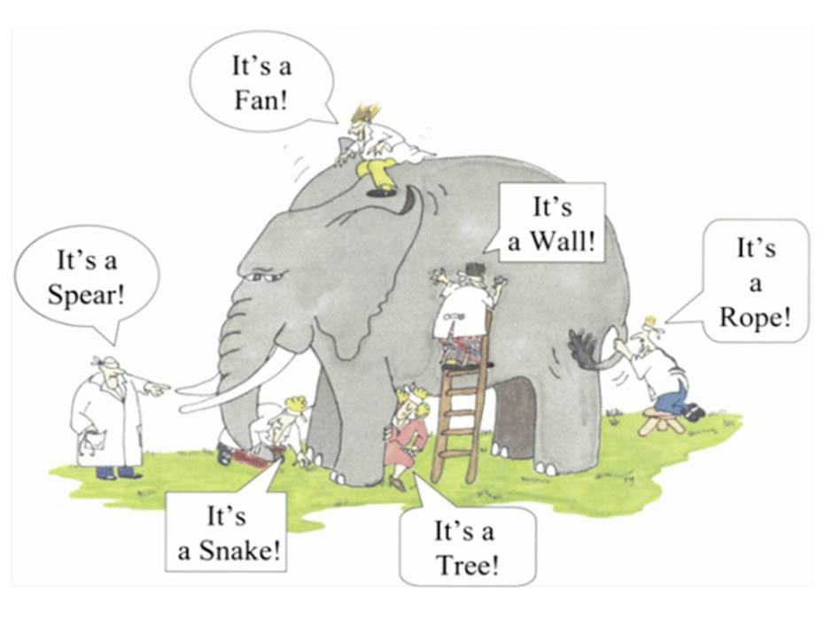

Slide 14

Interoperability is the ability of different autonomous organisations or systems to communicate and work together.

Slide 15





OSLO
Semantische interoperabiliteit
Semantic interoperability
Technische interoperabiliteit
Technical interoperability
Tools
Tools
Support & Governance
Support & Governance
Use cases
Use cases

Slide 16


Bottom-up development
Notes:
Icons made by Freepik from www.flaticon.com
Grassroots initiative

Slide 17
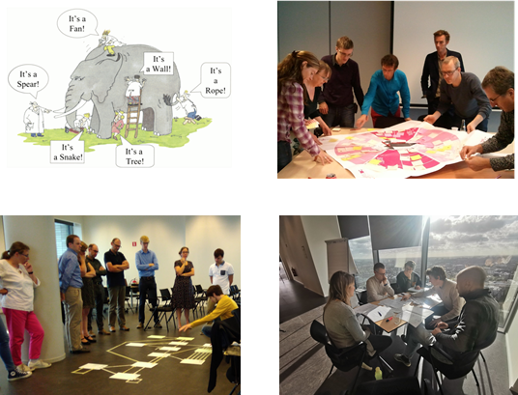

Slide 18
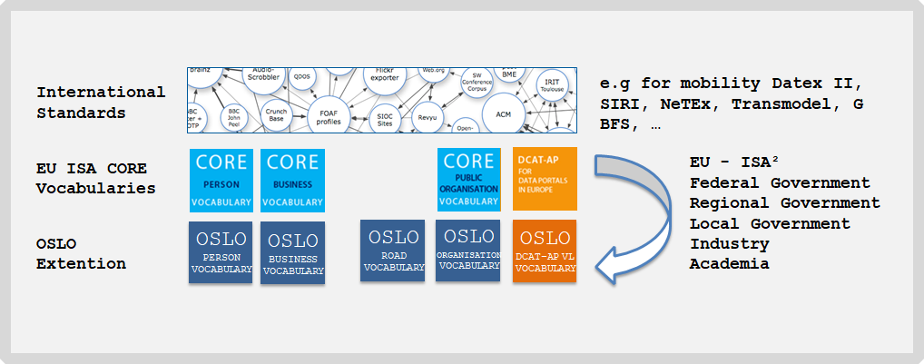
Share and reuse
e.g. INSPIRE

Slide 19
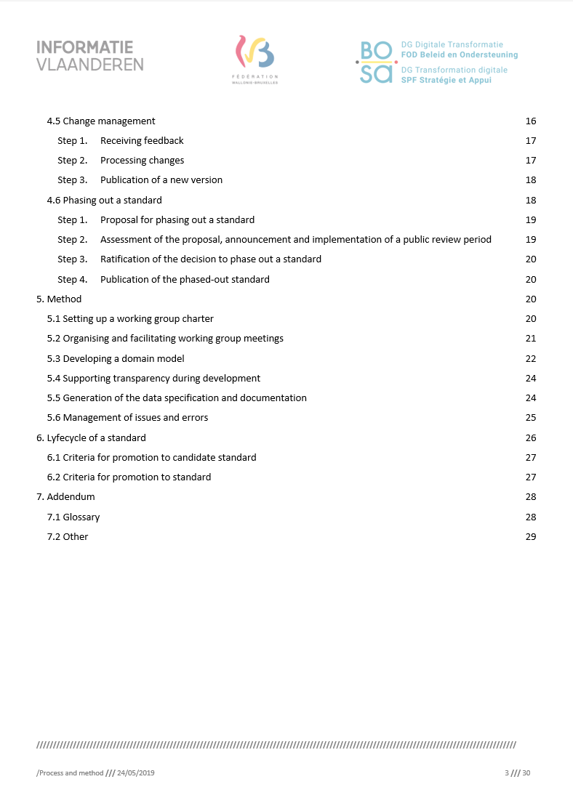
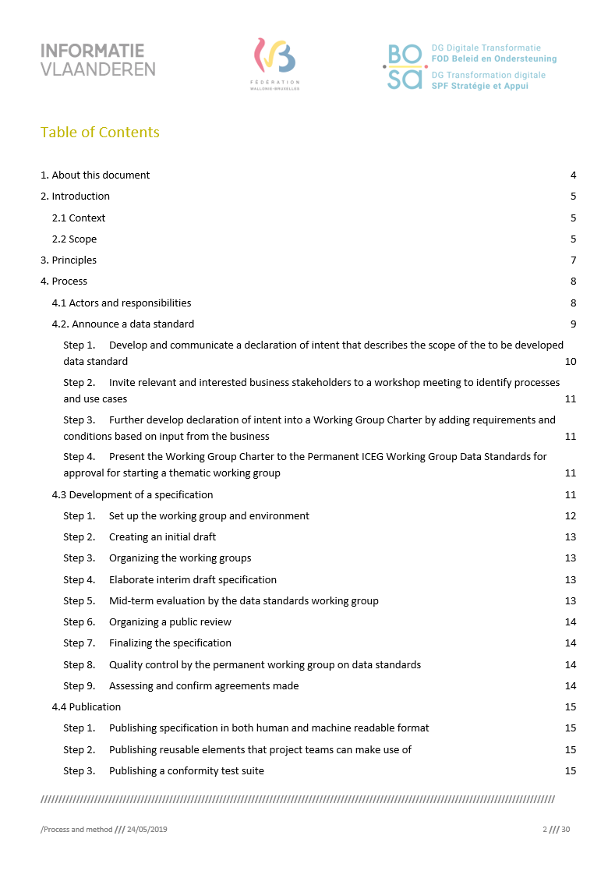

Process and method
Scalable process for connecting, developing, adapting and phasing out data standards
Download the file via the following link: process and method

Slide 20
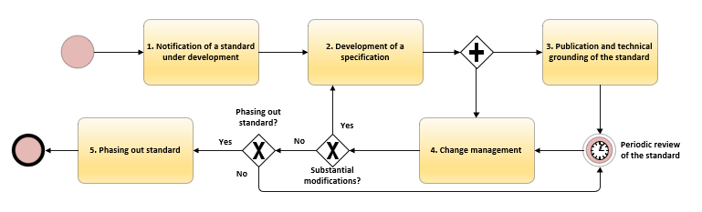
Context of the workshops
Workshops as part of a wider process
Objective: Consensus around data standards carried by multiple stakeholders
Process and method for the development of a data standard

Slide 21
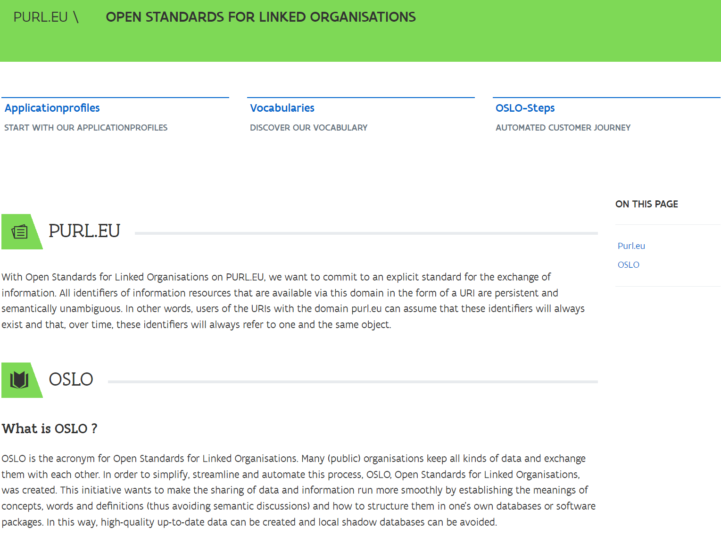
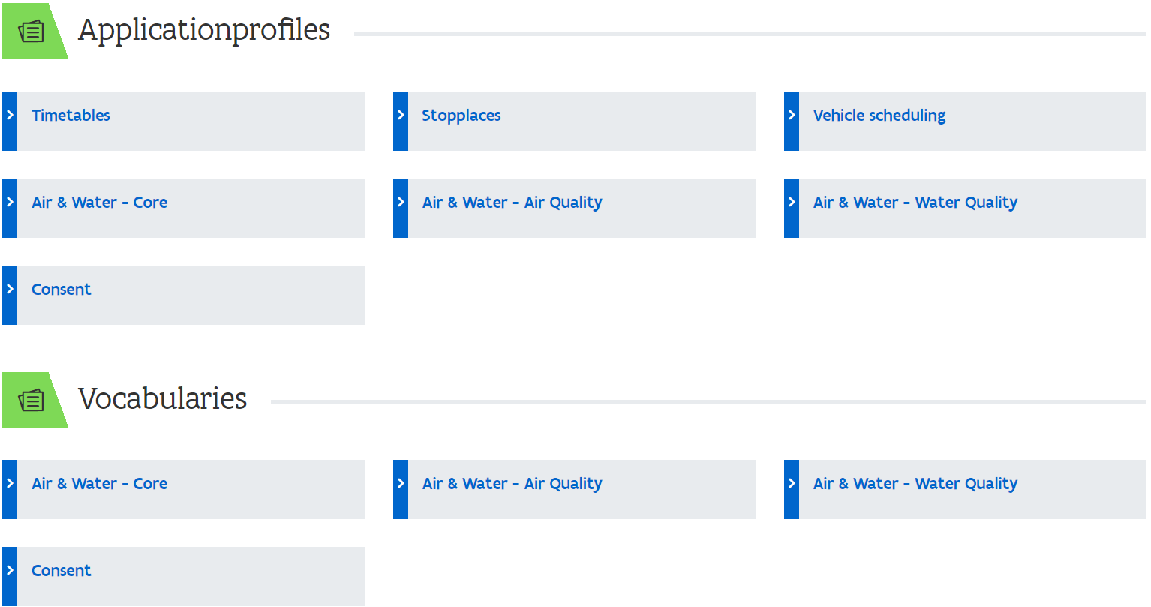
PURL.eu

Slide 22

Flemish model
OSLO Hoppinpunten

Slide 23
Introduction
Joris Cornu
Department of Mobility and Public Works
Government of Flanders
26 April 2022

Slide 24
Overview
The new mobility vision
Hoppinpoints
Realization
Database

Slide 25
The new mobility vision

Slide 26
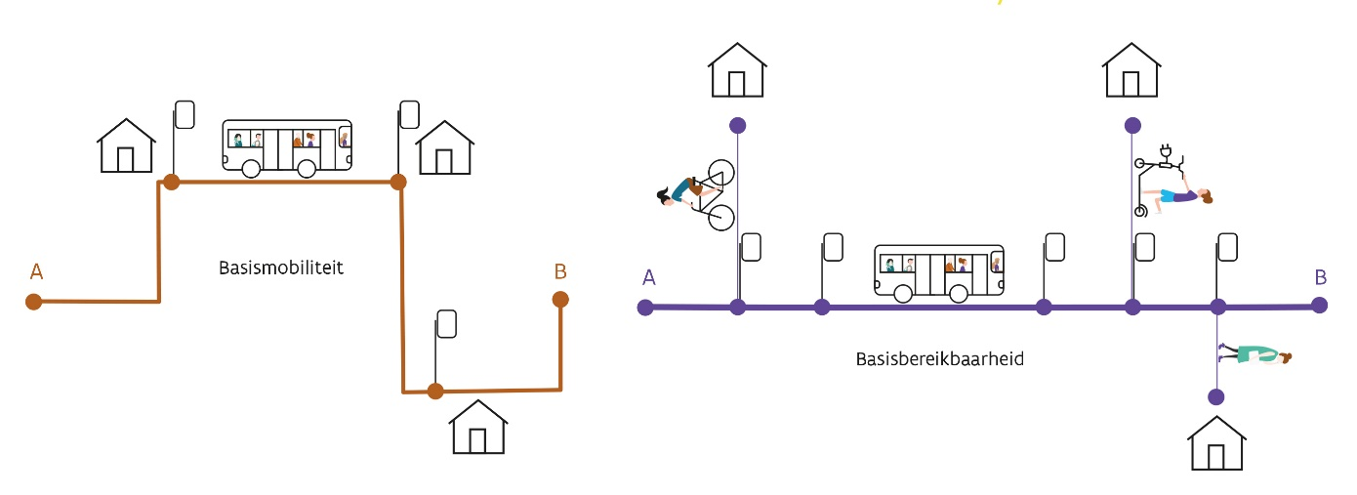
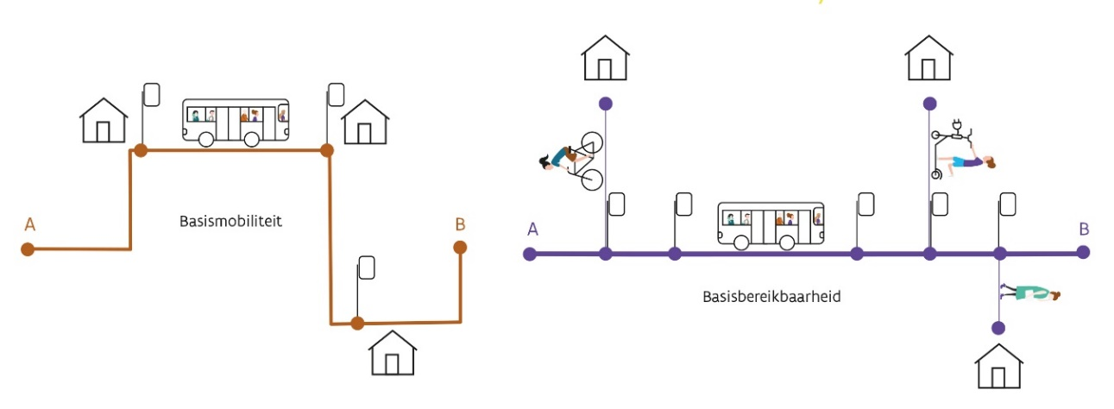
The new mobility vision
Accessibility
Important locations from a societal point of view must be easy to reach for all users.
Redraw the network and infrastructure for all transport modes.
Sustainable, safe, intelligent and multimodal mobility system.

Slide 27
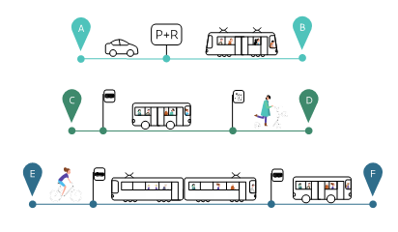

Combining modes, a reflex
Stimulate change in behaviour by making it easier to combine modes
The new mobility brand will guide travelers through the mobility landscape

Slide 28
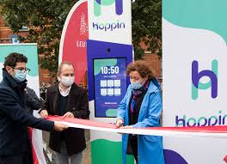
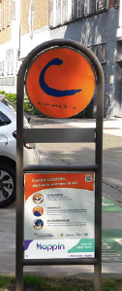
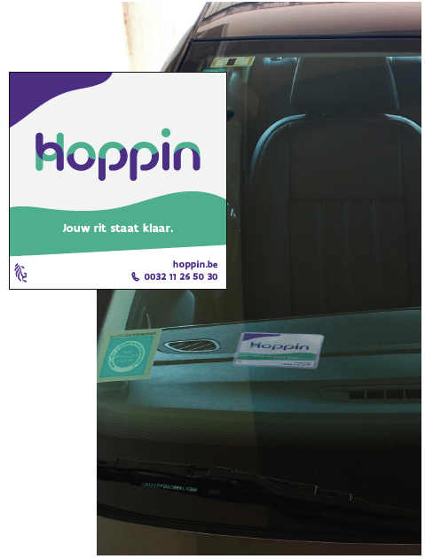
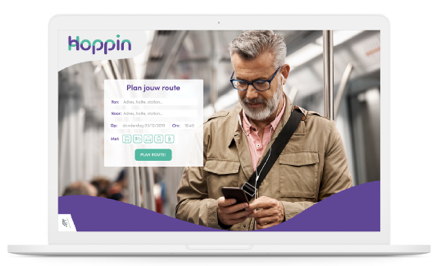
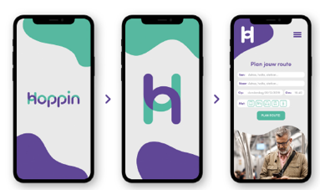
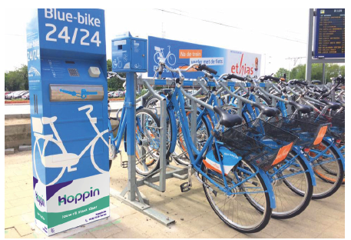
Example: application of Hoppin on flexible transport and location for shared mobility
Example:
Hoppin column
in Leuven
Example: application of Hoppin on app and website
* Examples from the corporate identity guidelines (version april 2021)

Slide 29
Hoppinpunten
Realization

Slide 30
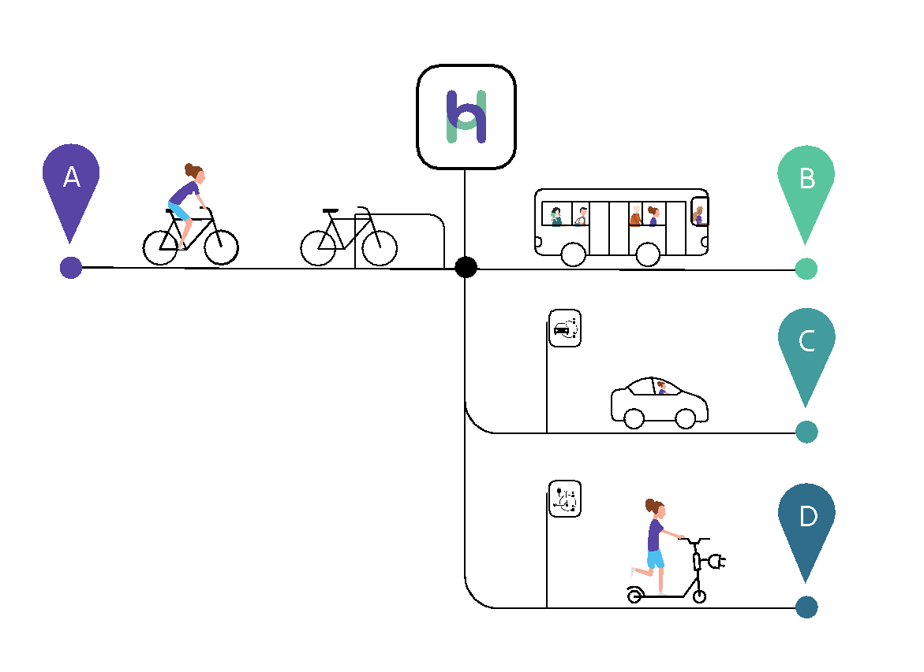
What is it about?
A Hoppinpoint is a type of Passenger Transport Hub, a node of different transport options adjusted to each other enabling users to change transport means smoothly
Hoppinpoints can provide other services (besides transport options)
Types (‘BVR Hoppinpunten’):
Interregional
Regional
Local
Neighbourhood

Slide 31
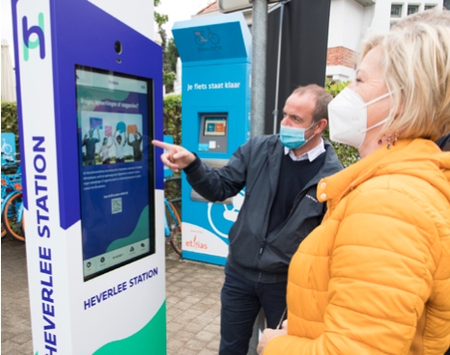
Quality requirements
‘BVR Hoppinpunten’
Accessibility
Minimal equipment
Parking (if needed, with adjusted and reserved places for disabled people)
Bicycle sheds (with space for outsized bikes)
Information carriers
Infrastructure for data exchange
Link to ‘BVR Hoppinpunten’

Slide 32
Hoppinpunten
Database

Slide 33
Database
Build a database (Digitaal Vlaanderen)
Based on OSLO Hoppinpunten
Content
Implementation & follow-up
Operational part (i.e. infrastructure)

Slide 34

Database
Content - Implementation & Follow-up
ID
Name
Location
Road infrastructure manager
Type
Status: Passenger Transport Hub vs. Hoppinpunt
Accessibility
Subsidies
…

Slide 35
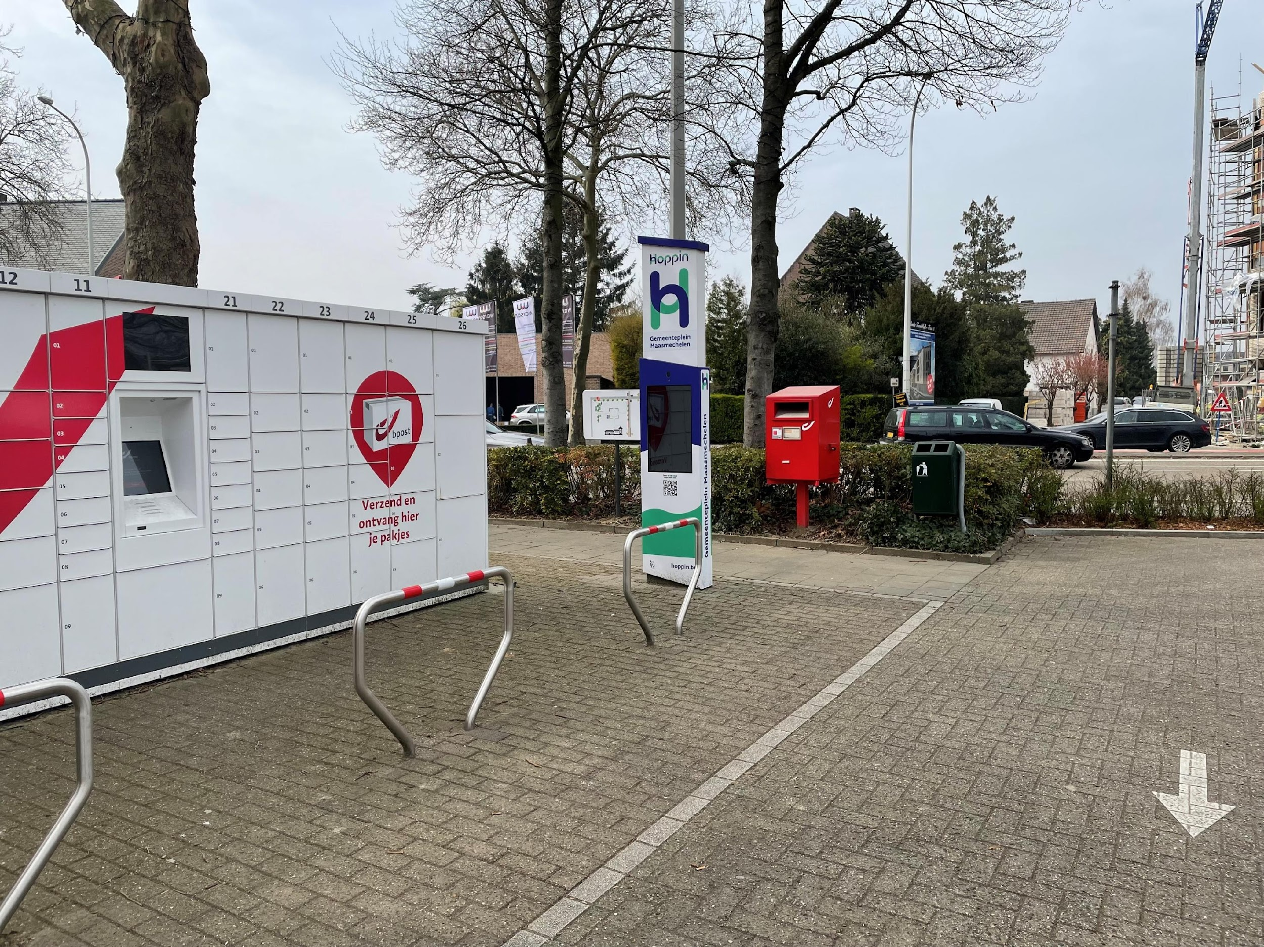
Database
Content - Operational part (i.e. infrastructure)
Column (digital or not?)
Charging points (e-mobility)
Mobility services
Train
Bus
Flex
…
Additional service
Post
Lockers
Bike repair service
…
…

Slide 36
The model Hoppinpunten

Slide 37
Reuse of Flemish standard
Existing Flemish standaard (OSLO Hoppinpunten)
Basis of this track
Based on (inter)national standards
Inspire (transport networks)
Mobivoc
NeTEx (Stop Places)
OSLO Mobiliteit: Trips en aanbod (OSLO Mobility: Trips and offers)
OSLO Mobiliteit: Planning en dienstregeling (OSLO Mobility: Planning and schedule)
OSLO Openbaar domein (OSLO Public domain)

Slide 38
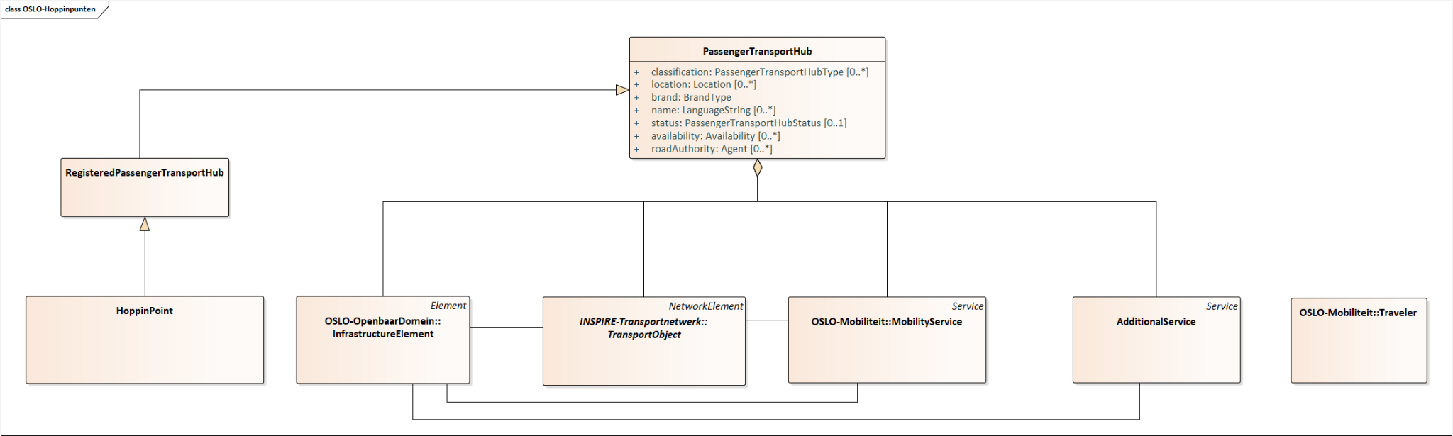
Foundation of the model

Slide 39
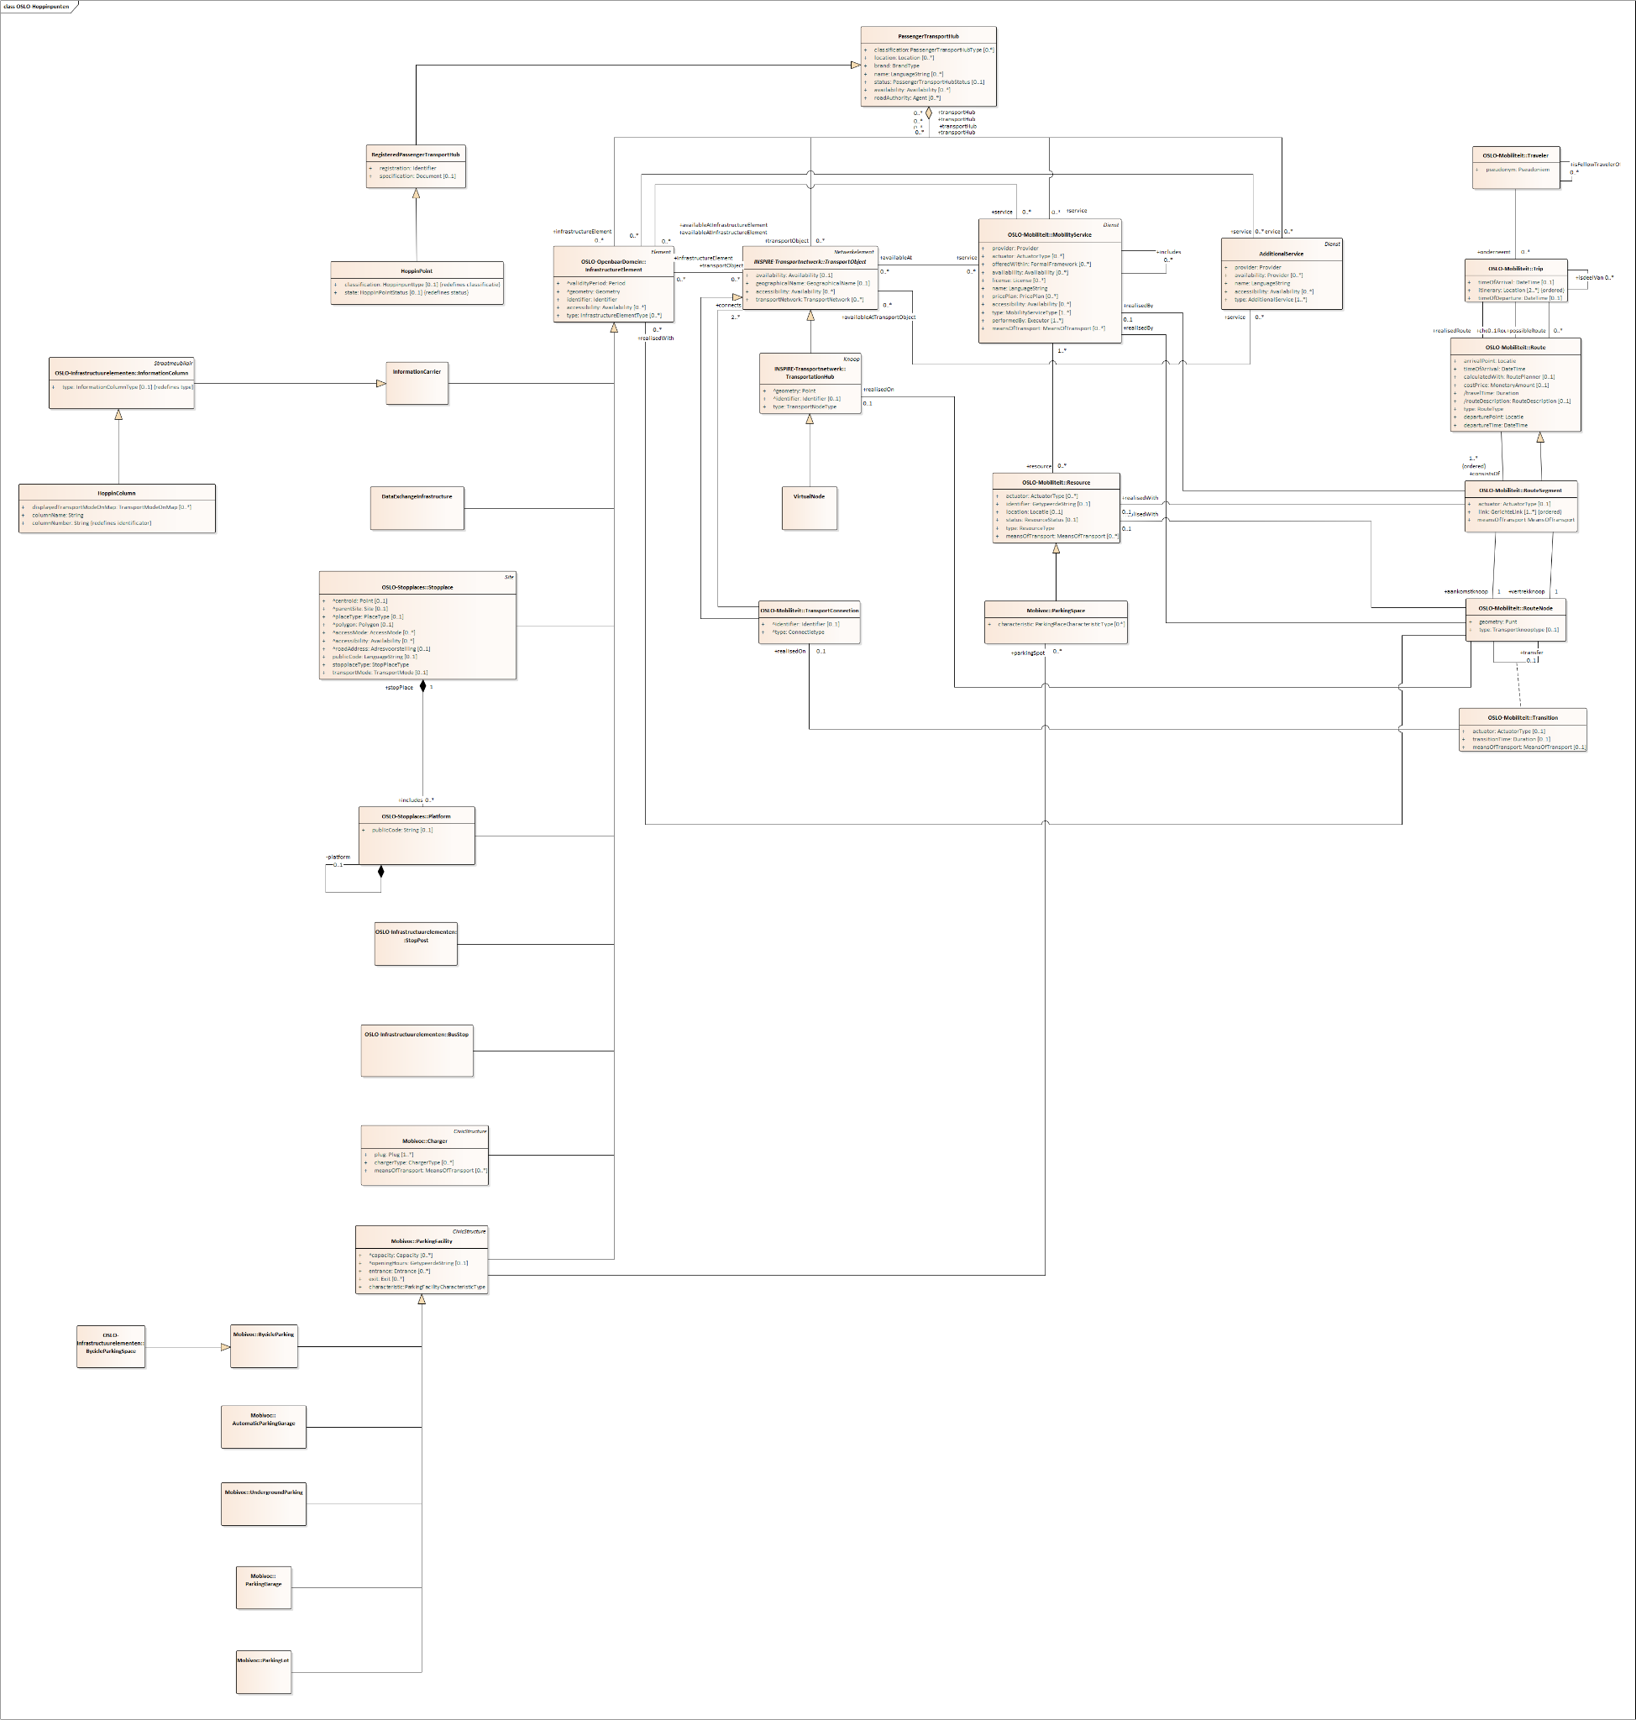
Full model
OSLO Hoppinpunten

Slide 40

Overzicht van de planning
Startdatum: 26 oktober 2021
Duur: 9 maanden
Vandaag
Break
Business werkgroep
Thematische werkgroep 2
Thematische werkgroep 4
Einde publieke reviewperiode
2021
oktober
november
december
januari
februari
maart
april
mei
juni
Thematische werkgroep 1
Thematische werkgroep 3
Start publieke reviewperiode
Implementatie van de draft specificatie

Slide 41
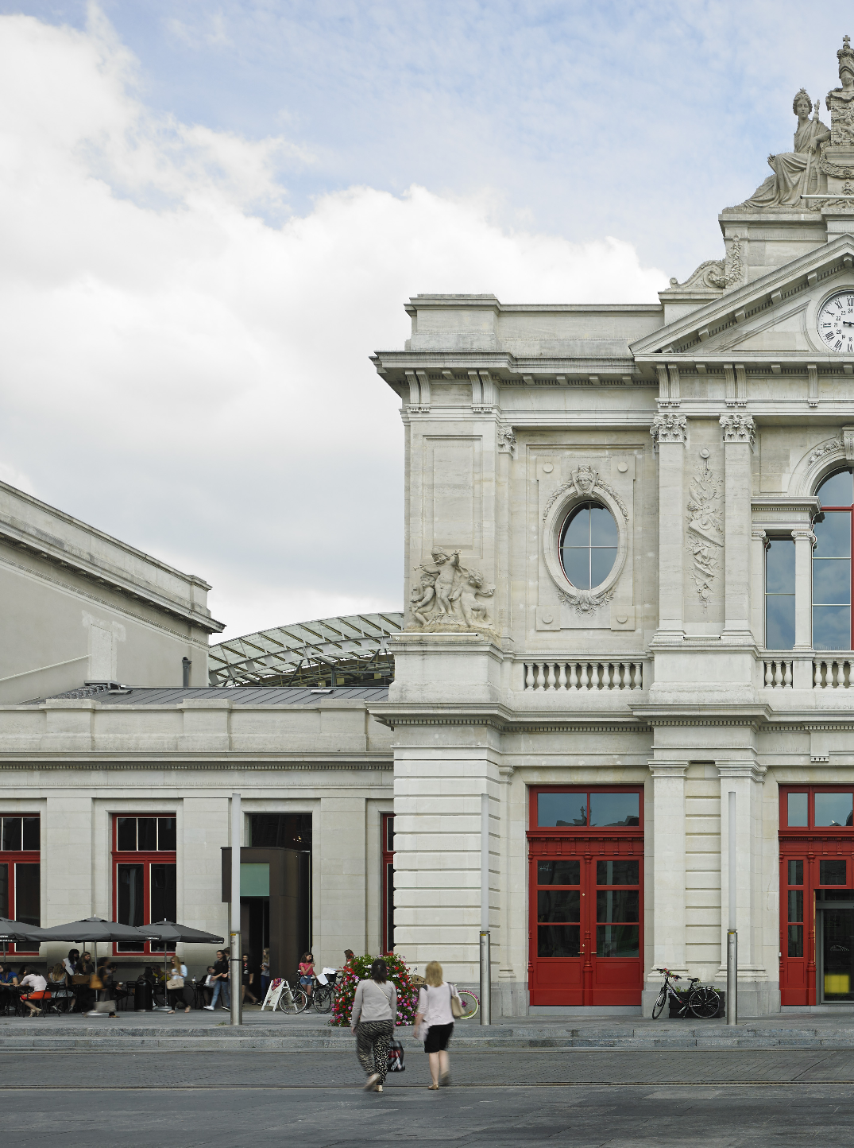
Object Diagram
Address
Benedenplein
3010 Kessel-Lo
Train station
Station of Leuven
Bike sharing
38 bikes of Blue-bike in a covered bicycle parking
Infrastructure
Information column

Slide 42
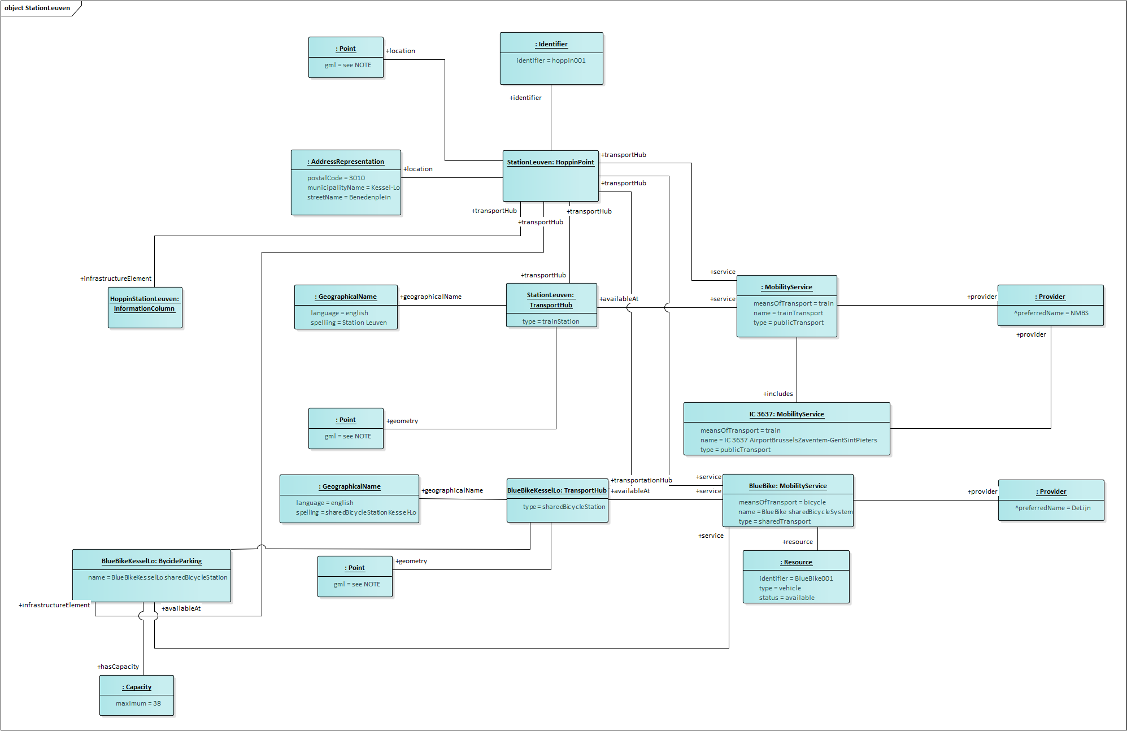
Object Diagram

Slide 43
Brainstorm

Slide 44

Time for action!

Slide 45
Q&A and Next Steps

Slide 46

What do we do…?
Don’t we have to add …?
Can’t we better …?
What about …?
Didn’t we forget …?

Slide 47
Next steps
Process the input of the brainstorm exercise.
Distribution of a report from this workshop. Feedback is certainly welcome!
Further investigation and preparation of the first thematic workshop
Information gathering via GitHub!

Slide 48
Planning
Thematic workshop 19th of May (09:00am - 12:00am)
Register via the following link: Thematic workshop 1
Business workshop
Thematic workshop 2
Start public review period
End public review period
2022
April
May
June
July
August
September
October
November
December
Thematic workshop 1
Thematic workshop 3 (Optional)
Implementation of the draft specification

Slide 49

Feedback & cooperation
Feedback/input can be provided via GitHub:
https://github.com/Informatievlaanderen/OSLOthema-passengerTransportHubs
Through the creation of issues
Feedback can be provided by e-mail to the following persons:
digitaal.vlaanderen@digitaal.vlaanderen.be
laurens.vercauteren@vlaanderen.be
arne.scheldeman@vlaanderen.be
Hoppinpunten: joris.cornu@mow.vlaanderen.be
GreenMov: clara.pezuela@atos.net

Slide 50
Thank you!

